Slide 1

Where in the World Are Your Trends Taking Place?
Data Vizards
Presenters: Shailesh Godkhindi
Rajeswari Natchiappan
T.J. Lawless

Slide 2
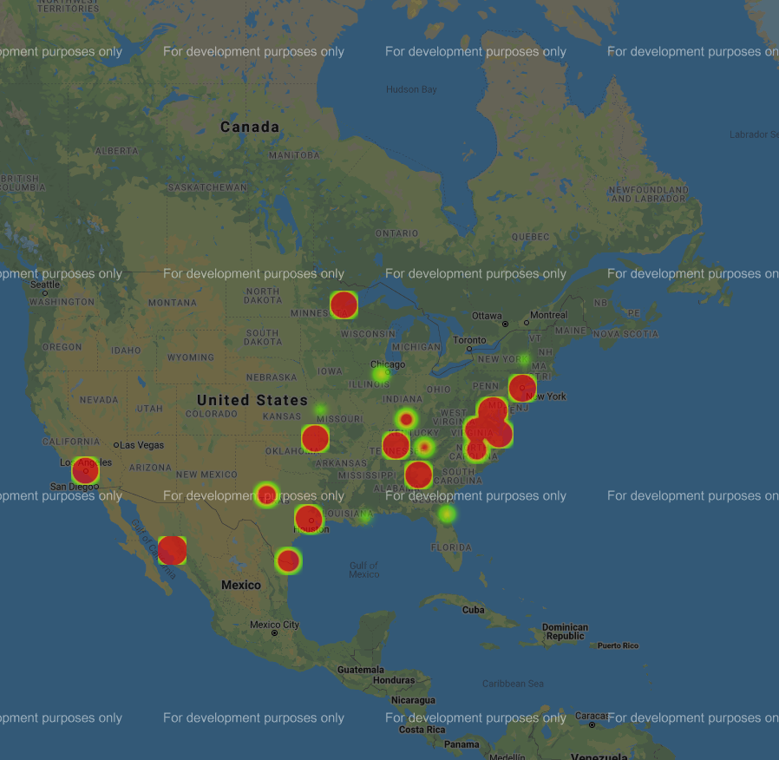
How about them Braves?!?!

Slide 3
Objectives
Understand how to track social media activity across the globe
Demonstrate the ability to input topic into program and print heatmap
Understand how you can use this tool in your everyday life

Slide 4
Benefits
Plan product launches in markets that are trending for your respective idea
Find new and trending restaurants wherever you’re at
Plan fun vacations to places that share similar interest

Slide 5
Overview
API Calls / Data Acquisition -Shailesh
Creating Pandas / Data Structures - Raji
Mapping & Moral Support - TJ

